Slide 1

Advanced Topics in MEL: Training Needs Assessment Results and Recommendations
Middle East Bureau
January 26, 2024
Presentation Delivered by Barbara Pando-Behnke and
Dan Killian with Management Systems International,
A Tetra Tech Company

Slide 2



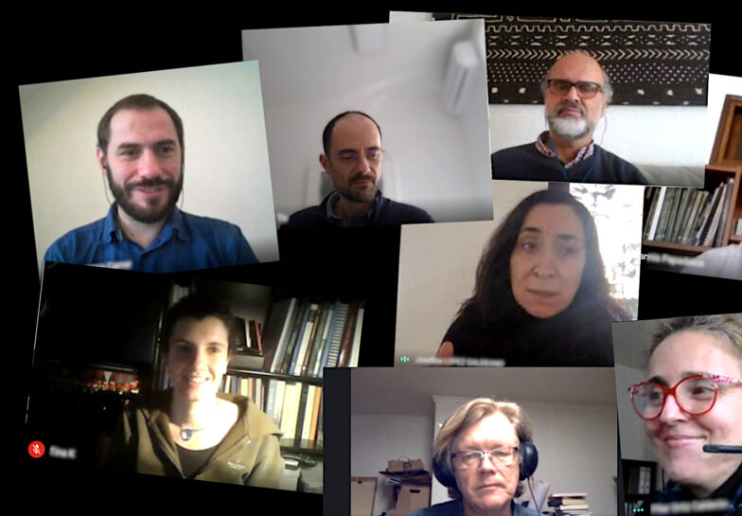



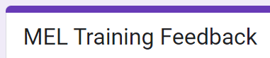
METHODOLOGY

Slide 3
NUMBER OF SURVEY RESPONDENTS, INTERVIEWEES, AND FOCUS GROUP PARTICIPANTS
Data Collection Method | Number of participants | Missions | MERP | ME bureau (DC)
Survey | 12 | Numbers unknown
Interviews | 6 | 3 | 1 | 1
Focus Group | 5 | 1 | 1 | 3
One FG participant was also interviewed.
No other FG participants were interviewed.
Aside from one interviewee, no others also participated in the FG.
Per USAID’s request, the survey did not ask respondents for names or location.

Slide 4
HIGHEST RANKED TOPICS ACROSS METHODS
Highest Ranked Topics | Survey | Interview | Focus Groups
Learning agendas/learning questions | 5 | 6 | 0
Randomized control trials/quasi-experimental methodology | 7 | 2 | 1
Survey representativeness in conflict areas | 8 | 2 | 0
Sector-specific MEL (health/education) | 7 | 1 | 1
CLA and knowledge management | 4 | 4 | 0
Third-party monitoring | 4 | 3 | 0
Data quality and utilization | 4 | 2 | 0
ArcGIS for non-GIS experts | 5 | 0 | 0
Survey accuracy | 3 | 0 | 0
Statistics | 1 | 1 | 0
* 12 persons responded to the survey
* 6 persons participated in the focus group
* 6 persons were interviewed

Slide 5
HIGHEST RANKED TOPICS ACROSS METHODS
Highest Ranked Topics | Survey | Interview | Focus Groups
Learning agendas/learning questions | 5 | 6 | 0
Randomized control trials/quasi-experimental methodology | 7 | 2 | 1
Survey representativeness in conflict areas | 8 | 2 | 0
Sector-specific MEL (health/education) | 7 | 1 | 1
CLA and knowledge management | 4 | 4 | 0
Third-party monitoring | 4 | 3 | 0
Data quality and utilization | 4 | 2 | 0
ArcGIS for non-GIS experts | 5 | 0 | 0
Survey accuracy | 3 | 0 | 0
Statistics | 1 | 1 | 0
* 12 persons responded to the survey
* 6 persons participated in the focus group
* 6 persons were interviewed

Slide 6
HIGHEST LEARNING APPROACHES ACROSS METHODS
Highest Ranked Learning Approaches | Survey | Interview | Focus Groups
1. Peer-to-peer learning | 7 | 5 | 4
2. Workshop | 6 | 4 | 4
3. Simulations | 6 | 3 | 1
3. Case studies | 6 | 4 | 0
3. Expert guest speakers offer TED-style talks | 7 | 2 | 1
Self-study | 4 | 2 | 0
* 12 persons responded to the survey
* 6 persons participated in the focus group
* 6 persons were interviewed

Slide 7
HIGHEST LEARNING APPROACHES ACROSS METHODS
Highest Ranked Learning Approaches | Survey | Interview | Focus Groups
1. Peer-to-peer learning | 7 | 5 | 4
2. Workshop | 6 | 4 | 4
3. Simulations | 6 | 3 | 1
3. Case studies | 6 | 4 | 0
3. Expert guest speakers offer TED-style talks | 7 | 2 | 1
Self-study | 4 | 2 | 0
* 12 persons responded to the survey
* 6 persons participated in the focus group
* 6 persons were interviewed

Slide 8
INTERVIEW SPECIFIC FINDINGS
FINDINGS | FINDINGS | FINDINGS
How to organize, analyze, present, and tell stories with data | Other means of data utilization beyond evaluation findings | Learning agendas at the MERP level
Managing shrinking MEL budgets and security realities | Learning/adaptive management at the Mission level | CLA/KM and TPM to support localization
Broader Mission PMP learning agenda into AMELPs and discussions with IPs | Integrate learning questions already used by the Mission into IP learning | Designing evaluations to develop learning agendas and questions

Slide 9
INTERVIEW SPECIFIC FINDINGS
Anything else?
Discuss “big movements”, i.e. Global Fragility Act.
Prepare for design workshop clinic
Build skills in Tableau or Power BI
Using monitoring for better decision-making
Prepare participants for design workshop clinic in the Fall.
Improve skills in summarizing results in charts and dashboards
Supporting Missions in tracking progress in agency priorities

Slide 10
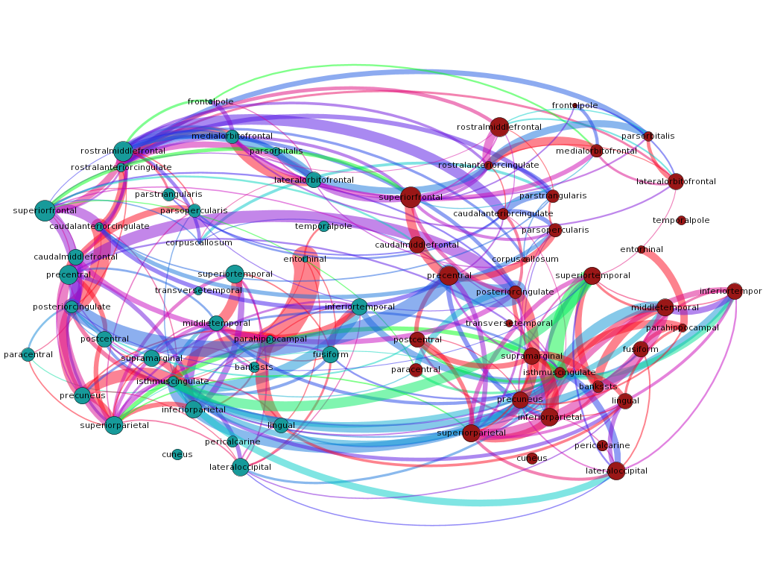


FOCUS GROUP SPECIFIC FINDINGS
Additional topics requested:
Infographics
Dashboarding
AI in MEL
Notes:
Infographics skills in mapping data and visualization
Dashboard – making and sharing
AI in M&E

Slide 11
RECOMMENDATIONS
Prioritize the following, high level topics and approaches:
Randomized control trials/quasi-experimental methodology
Complex data collection methods and their effective use in conflict affected areas
CLA: Deep dives into co-creation, learning agendas and adaptive management
Newer analytical methods with possible future applications in MEL practice
Intentionally use TPM and sector-specific MEL case studies

Slide 12
RECOMMENDATIONS
Use the following learning approaches by priority:
Peer-to-peer learning
Case studies
Expert guest speakers offer TED-style talks
Workshopping
Simulations

Slide 13
PROPOSED LEARNING OBJECTIVES
Learning Objective 1: Compare/contrast several experimental and quasi-experimental evaluation designs based on their best uses and challenges.
Learning Objective 2: Compare the challenges and subsequent approaches of various data collection methods when used in conflict-affected areas.
Learning Objective 3: Compile best practices when designing learning agendas at the Mission, programmatic, and activity levels.
Learning Objective 4: Discuss newer analytical methods that may have future applications in MEL practice.

Slide 14
PROPOSED HIGH LEVEL TRAINING AGENDA
Day One: Complex Evaluation Designs | Day Two: Complex monitoring methods | Day Three: Logic models and learning agendas | Day Four: Speculative approaches to MEL
1. Review the policy context | 1. Statistical matching | 1. Logic modeling is dead! Long live logic modeling! | 1. Gamify MEL – Measuring with behavioral games
2. Potential outcomes | 2. Where has all the money gone?? | 2. Learning agendas: theory and practice | 2. Bayes’ Rules!
3. Evaluation designs for identifying causal effects | 3. Where has all the money gone?? - Continued | 3. TED Talk: GIS | Bayesian Befores. Tell us what you know now.
4. TED Talk: Measurement in Conflict Zones | 4. Sampling OMG!! | 4. Lightning Talk Panel Discussion | 4. Welcoming our new machine learning overlords
5.Managing RCTs | 5. Sampling OMG!! Continued | 5. Learning agenda workshop | 5. Localization and its MEL
5. RCTs | 6. TED Talk: Remote Tech and AI in conflict zones | 6. Learning agenda plenary discussion
 | 7. Data collection in conflict
 | 8. Data collection in conflict continued
* Day Five: Visit pre-selected site to apply new concepts and skills.

Slide 15
NEXT STEPS
USAID provides feedback on training description, learning objectives, and agenda Jan 31
USAID submits application to CSOD for CLPs by late Jan/early Feb
MSI finalize executive agenda document by early Feb
MSI develops a key SME stakeholder group by early Feb
MSI submits draft session outlines of all sessions by Feb 9
USAID announces the launch of training registration by mid-Feb
USAID SMEs provide feedback on session content outlines by Feb 16

Slide 16
QUESTIONS?

